Slide 1
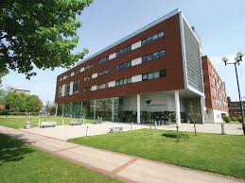
5th EAWOP EARLY CAREER SUMMER SCHOOL
12st – 16th September 2016,
Aston University, Birmingham, UK
EVALUATION

Slide 2
Participants
33 researchers were selected from 14 countries

Slide 3
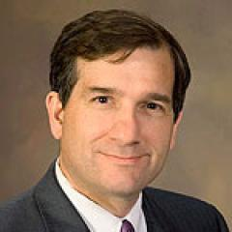
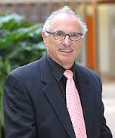
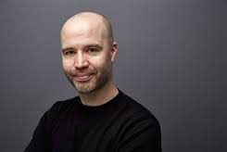
Invited Senior Scholars
Professor Russell Cropanzano Professor Neal Ashkanasy Professor Richard Crisp Professor Sandra Ohly
University of Colorado, US The University of Queensland, Australia Aston University, UK Kassel University, Geremany

Slide 4
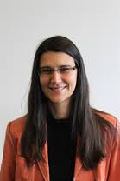
Invited Senior Scholars
Professor Daan van Knippenberg Professor Ute Hulsheger Professor Ute Stephan Professor Jeremy Dawson
Erasmus University, Netherlands Maastricht University, Netherlands Aston University, UK University of Sheffield, UK

Slide 5
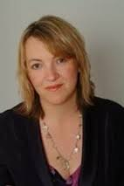
Senior Scholars
A practitioner perspective was provided by Professor Fiona Patterson
Founder of the Work Psychology Group, UK
Researcher at Cambridge University
Visiting professor at City University, London, UK

Slide 6
Summer School Activities
Two keynotes by Professors Cropanzano & Ashkanasy
Roundtable discussions
Research methods clinics
Career management sessions
Skills workshops on publishing and the R&R process
Meet the practitioners session
Networking
Poster session

Slide 7
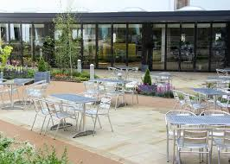
Social Programme
Meals out and about across Birmingham
Dinner by the canals
A spicy curry
On campus catering at Aston

Slide 8
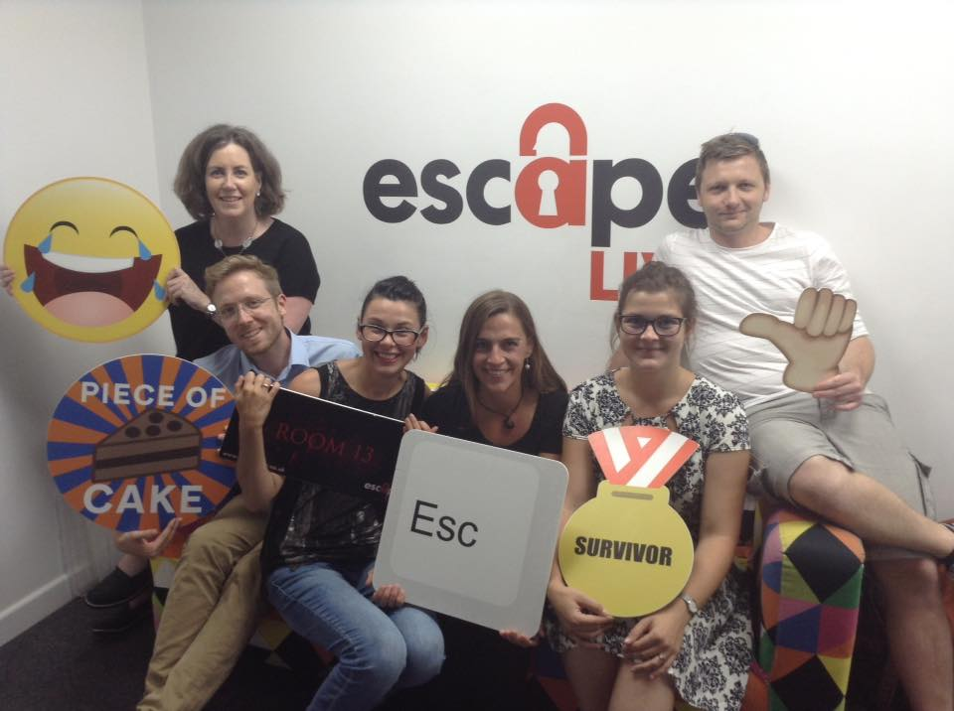
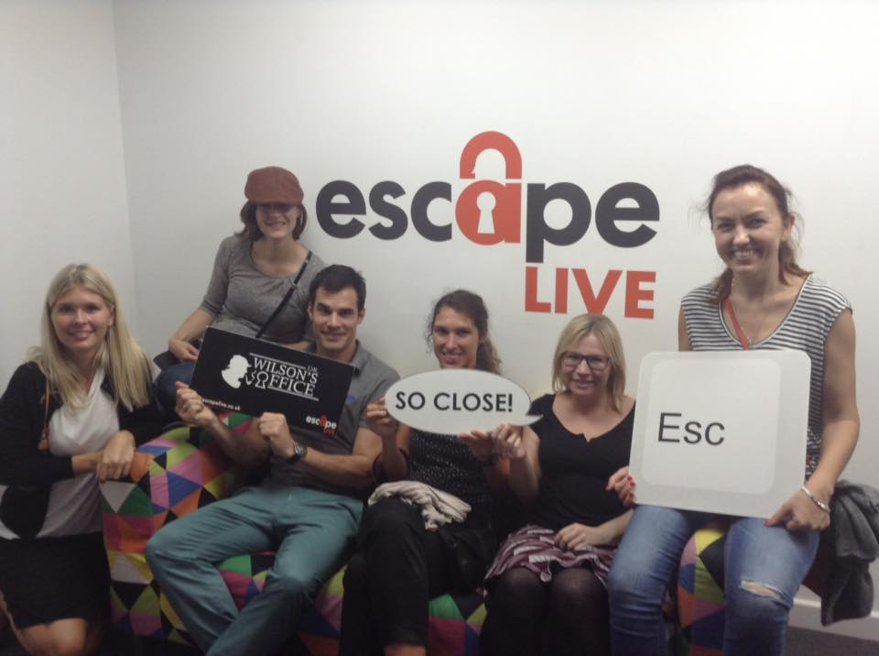
Social activities
Delegates took part in an interactive game where they had to escape from a virtual room – here are some of them just after!

Slide 9
Programme
Monday | Tuesday | Wednesday | Thursday | Friday
 | Breakfast | Breakfast | Breakfast | Breakfast
 | Keynote | Research Methods Clinic - 1 | Keynote | Research Methods Clinic –2
 | Tea Break | Tea Break | Tea Break | Tea Break
 | Research speed dating | Roundtables 1 (Working Paper – Part 1) | Roundtables 2 (Working Paper – Part 2) | Skill Workshop 3 (Funding)
 | Lunch
 |  | Lunch | Lunch | Lunch
 | Panel Discussion (Publishing)
 |  | Skill Workshop 1 Revise & Resubmit process | Skill Workshop 2 (Mentoring) | Networking & Conclusion
Arrival & Registration |  |  |  | Departure
 | Tea Break | Tea Break | Tea Break
 | Career Management (Navigating your academic career) | Poster Session (Prize awarded) | Meet the Practitioners
 |  | Social activity
Welcome Reception & Opening | Break |  | Break
Dinner | Dinner | Dinner | Dinner

Slide 10
EVALUATION BY THE PARTICIPANTS
Positive aspects
Kindness and availability of speakers and organizers
The initiative to bring together people that are both researchers and practitioners
The research speed-dating exercise
The networking: people, drinks, experiences.
Getting to know people; getting feedback for my research; everything was perfectly organized; the schedule was filled but still there was enough time to relax
The content and roll out was fantastic. The mix of experts and participants was good. The food was great.

Slide 11
EVALUATION BY THE PARTICIPANTS
Positive aspects
getting to know young academics / likeminded people in Europe in the same or similar disciplines
getting feedback from leading (senior) scholars in the field.
The organisers were incredibly friendly and professional. They did a great job of creating a relaxed and productive atmosphere for the week.
Interesting discussions with senior and junior academics, great developmental sessions on the R&R process and diary studies
The positive feedback from my colleagues and academics and the ability to network and talk to young academics in similar situation as me.

Slide 12
EVALUATION BY THE PARTICIPANTS
Room for improvement
Match PhD students and early career researchers for some activities
More in-depth research methods where possible
Have more formal “sharing time” and feedback sessions, not necessary with people with similar research topics
One less session per day or longer lunch
A session on building a coherent research identity could have been beneficial.
More time in roundtable discussions, possibly categorise them by theory, methods and analysis

Slide 13
5th EAWOP EARLY CAREER SUMMER SCHOOL
12st – 16th September 2016,
Aston University, Birmingham, UK

